Slide 1

Namma Yatri: Operational Performance & Strategy Insights
A Report on Visualisation and Analysis Based on Power BI Analysis (By Gayatri Behera)
Presented to: Management Leadership

Slide 2

Agenda
Business Objective
Key Insights
Core Challenges
Strategic Recommendations
Expected Impact

Slide 3
Business Objective
Evaluate ride performance and customer behavior
Identify inefficiencies in ride completion
Improve:
  Conversion
  Customer experience
  Revenue generation

Slide 4
Key Metrics Snapshot
  Conversion Rate: 45%
  Customer Cancellation: 48.17%
  Driver Cancellation: 47.25%
👉 Nearly 1 in 2 rides gets cancelled

Slide 5
Key Insights
Demand Insights
Peak demand reaches 50+ searches per hour
Demand varies across:
    Time
    Zones
👉 Demand is predictable and recurring
Revenue Insights
Revenue contribution per time slot: 3.5% – 5.99%
Not directly proportional to demand
👉 Pricing strategy impacts revenue

Slide 6
Key Insights
Zone Insights
Top zones:
  Ramanagaram (~39 trips)
  Yeshwanthpur (~36 trips)
  Bangalore South (~33 trips)
👉 Few zones generate majority of trips

Slide 7
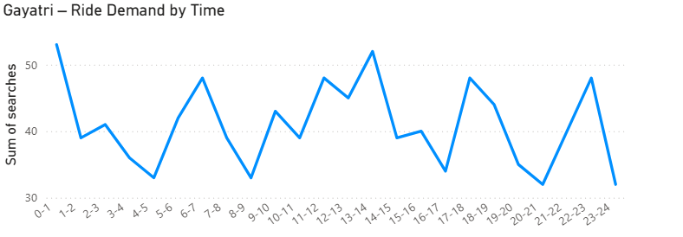

Slide 8

Core Challenges
Demand vs Conversion Gap
  High demand (50+ searches)
  Low conversion (45%)
  High cancellations (~48%)
👉 Out of 100 searches:
  45 completed
  ~55 drop off

Slide 9
Strategic Focus Areas
Improve conversion
Reduce cancellations
Optimize driver allocation
Enhance pricing strategy

Slide 10
Recommendations
Improve Conversion
Provide accurate ETA and fare
Reduce wait time
Retarget drop-off users
👉 Can increase conversion from 45% → 55%+
Reduce Cancellations
Customer penalties
Driver incentives
Better ride matching
👉 Can reduce cancellations by 10–15%

Slide 11
Recommendations
Optimize Supply
Focus on peak demand periods
Allocate drivers dynamically
👉 Improve ride availability and reduce wait time
Pricing Strategy
Use micro-surge pricing
Avoid excessive surge
Offer off-peak discounts
👉 Improve conversion and revenue

Slide 12
Expected Business Impact
  Increase conversion (45% → 55%+)
  Reduce cancellations (~48% → lower)
  Improve customer satisfaction
  Increase revenue and efficiency
Conclusion
  Namma Yatri faces a demand-supply mismatch where out of every 100 searches, only 45 convert into rides, highlighting a major operational efficiency gap.

Slide 13
Thank you

